Slide 1

Vel Tech Rangarajan Dr. Sagunthala R&D Institute of Science and Technology
School of Computing
Department of Computer Science and Engineering
10211CS224 / FULL STACK APPLICATION DEVELOPMENT (JAVA)
PROJECT REVIEW : MILESTONE PROJECT – 1
Date: 01-02-2026
Relational Inventory Control & Stock Tracking System
SDG: SDG No – SDG9- Industry, Innovation and Infrastructure
Presented By:
THOKALA VARSHITHA CHOWDARY – VTU26428 – 23UECS0568
Courses Handling Faculty:
Dr. HEMAMALINI
Assistant Professor(Senior Grade)-

Slide 2
INTRODUCTION
1
Inventory management is an essential part of any business to track products, stock levels, and transactions efficiently.
Traditional manual systems are time-consuming, error-prone, and difficult to maintain as business grows.
This system helps store and organize data in tables such as products, suppliers, orders, and stock details.
It allows real-time tracking of stock levels, reducing the risk of overstocking or stock shortages.
The system improves accuracy by automating calculations and reducing human errors.
This project develops a Relational Inventory Control & Stock Tracking System to manage inventory efficiently.
The system uses a relational database to store data in structured tables, making it easy to access and manage information.
It is scalable, meaning it can handle increasing data as the business grows.
It can be used in various domains such as retail stores, warehouses, and e-commerce platforms.
2
3
4
5
6
7
8
9

Slide 3
PROBLEM STATEMENT
1
2
Many businesses still use manual methods to manage inventory, which are slow and difficult to maintain.
Manual record-keeping often leads to errors such as incorrect stock levels and missing data.
There is no proper system to track real-time stock availability and movement.
Businesses face problems like overstocking or running out of stock due to poor tracking.
Data is not organized properly, making it hard to search and update information.
Lack of automation increases workload and reduces overall efficiency.
There is a need for a reliable and efficient system to manage inventory accurately.
Managing large amounts of inventory data becomes complex without a proper system.
Limited accessibility, as manual records cannot be accessed anytime or from anywhere.
3
4
5
6
7
8
9

Slide 4
OBJECTIVE(S)
1
2
3
To develop a system that helps businesses manage inventory efficiently, reducing time and effort compared to manual methods.
To organize and store all inventory-related data using a relational database, so that information is structured and easy to access.
To minimize errors in stock management by automating routine operations such as adding, updating, and deleting inventory records.
To generate reports and analytics that assist in business decision-making and understanding stock trends.
4
5
6
7
8
9

Slide 5
PROPOSED SYSTEM
1
2
The proposed system manages inventory and stock digitally, replacing slow and error-prone manual methods.
Users can add new stock, update existing records, delete obsolete items, and view inventory details, making stock management efficient and simple.
Stock levels are updated in real-time whenever items are added, sold, or removed, helping businesses prevent shortages or overstocking.
All product, supplier, and transaction details are stored in a relational database, ensuring data is structured, secure, and easy to retrieve when needed.
The system has a login module to allow only authorized users to access it.
3
4
5
6
7
8
9

Slide 6
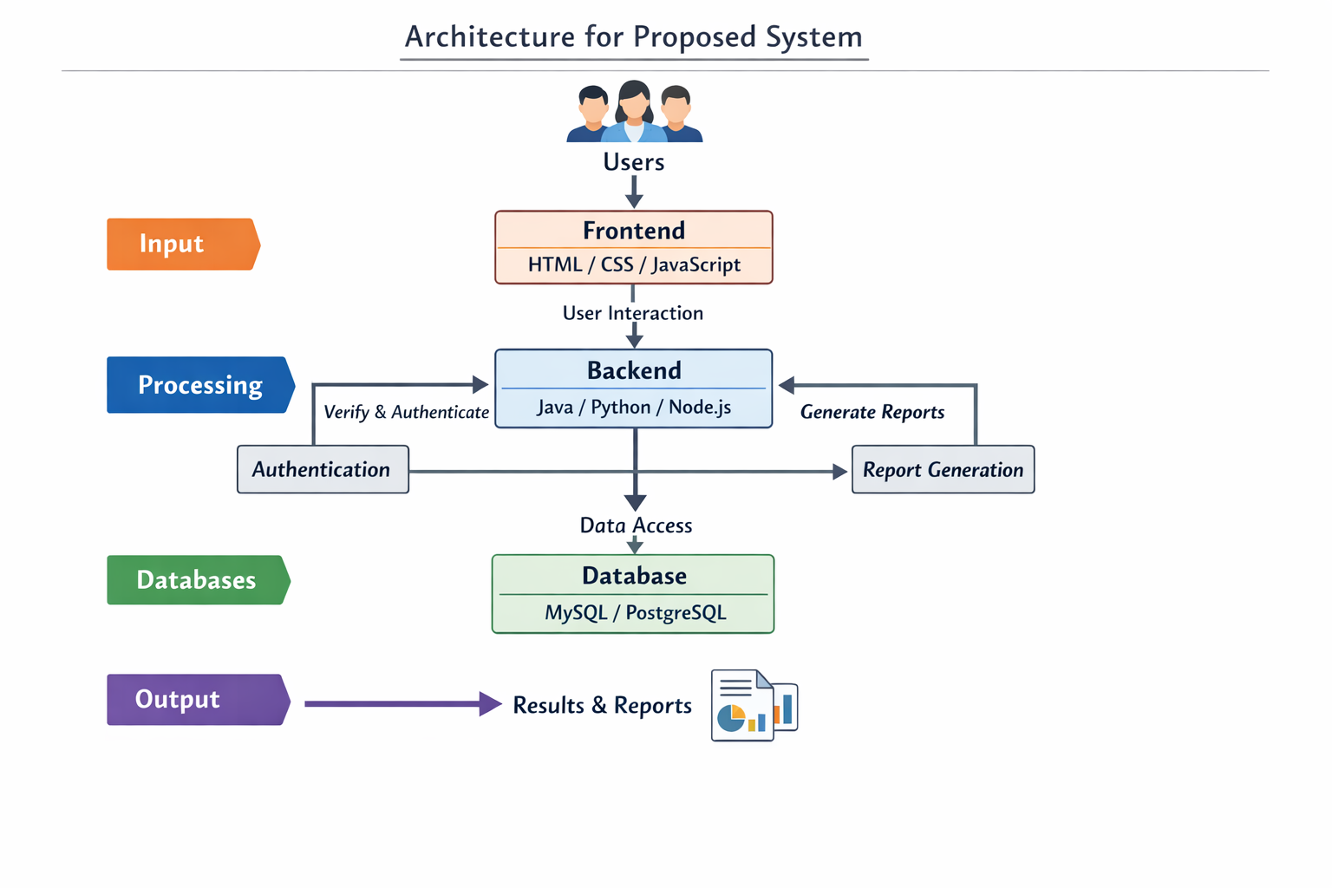
PROPOSED SYSTEM ARCHITECTURE
1
2
3
4
5
6
7
8
9

Slide 7
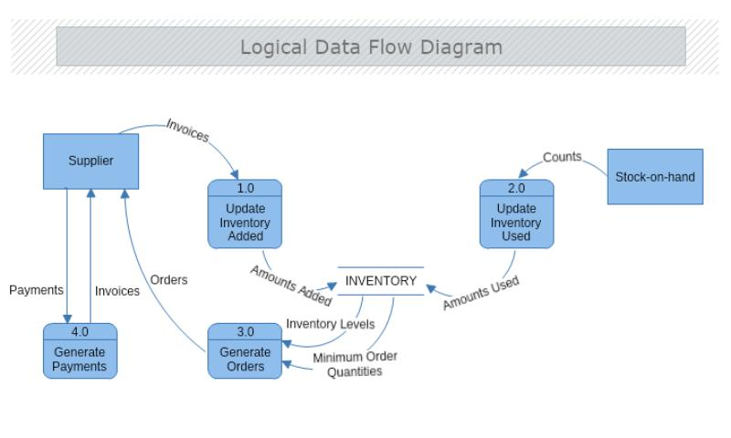
WORKFLOW
1
2
3
4
5
6
7
8
9

Slide 8
TECHNOLOGIES USED
1
Frontend:
HTML
Backend:
PHP
Database:
MySQL
Tools:
VS Code
XAMPP
Hardware / Software Requirements:
Intel i3 or above
4GB RAM (Minimum)
Windows 10/11
Web Browser (Chrome/Edge)
XAMPP Server
2
3
4
5
6
7
8
9

Slide 9
MODULE DESCRIPTION
Module 1: Product Management Model
The Product Management Model is responsible for handling all product-related information in the system. It allows users to add new products by entering details such as product name and quantity.
Enables deletion of products.
Module 2: Inventory Control Model
This model also helps in identifying low stock situations, which allows users to take necessary actions such as restocking.
Helps monitor current inventory status.
Module 3: Database Management
This module connects the application to the MySQL database.
It performs data insertion, retrieval, updating, and deletion operations.
Module 4: User Interface Model
This model ensures that the system is easy to use, accessible, and provides a smooth user experience.
Displays data in tabular format.
1
2
3
4
5
6
7
8
9

Slide 10
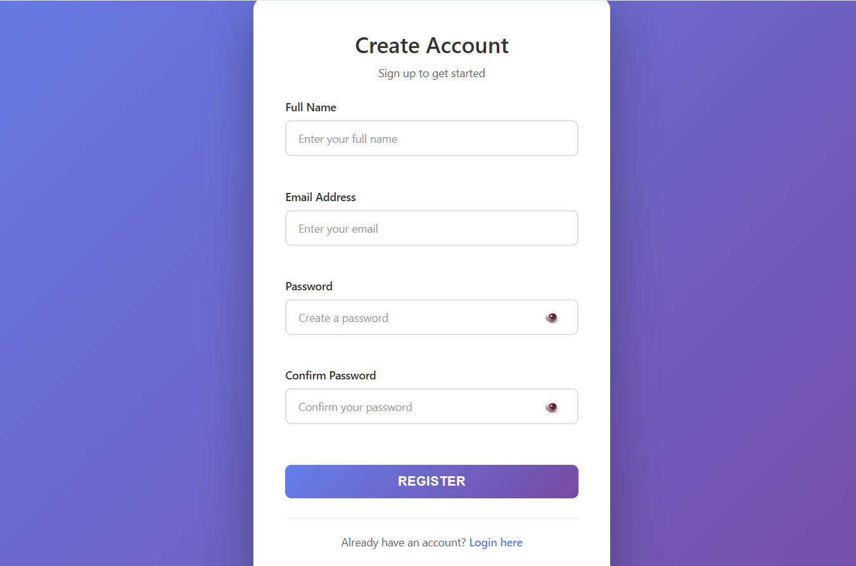
IMPLEMENTATION SCREENSHOTS
1
Allows new users to create an account by entering required details such as name, email, and password with proper validation.
The entered information is securely stored in the database, enabling users to log in and access the system features.
2
3
4
5
6
7
8
9

Slide 11
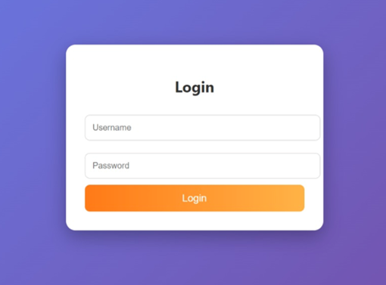
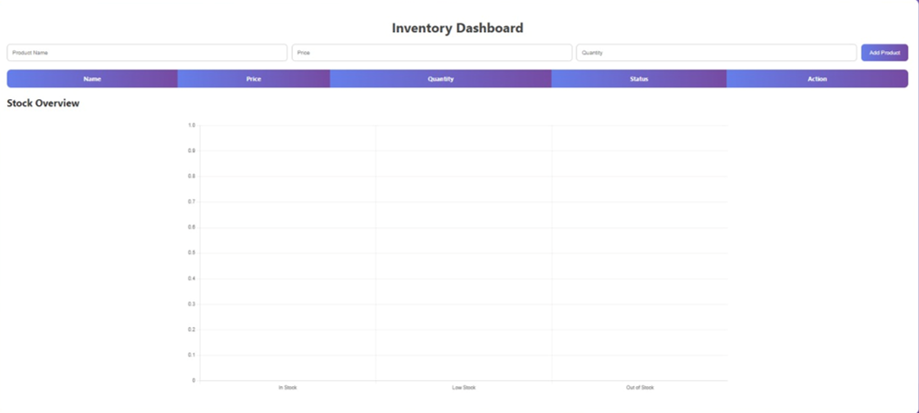
IMPLEMENTATION SCREENSHOTS
Allows registered users to enter their email and password to securely access their account within the system.
The system verifies the credentials with the database and grants access to the dashboard upon successful authentication.
1
2
3
4
5
6
7
8(A)
9

Slide 12
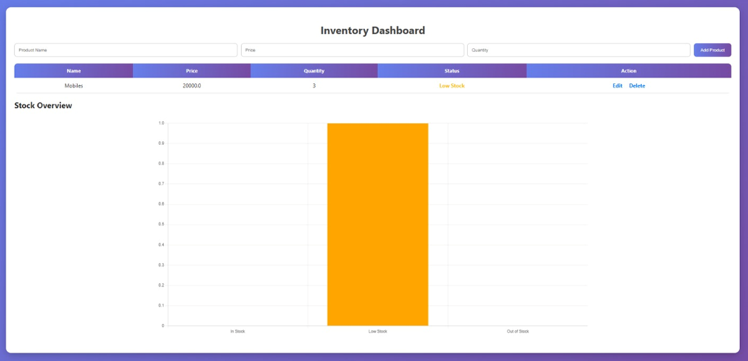
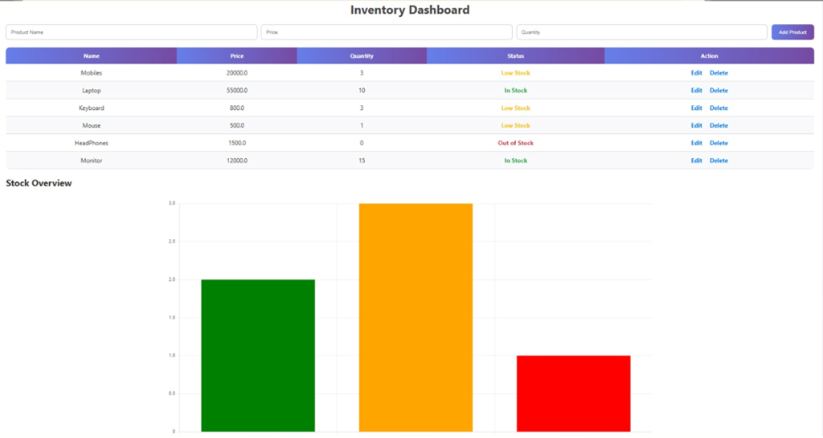
IMPLEMENTATION SCREENSHOTS
Admin can add new products with name and quantity into the system.
Ensures proper stock entry and maintains accurate inventory records.
1
2
3
4
5
6
7
8(B)
9

Slide 13
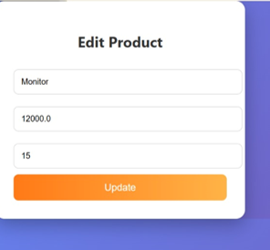
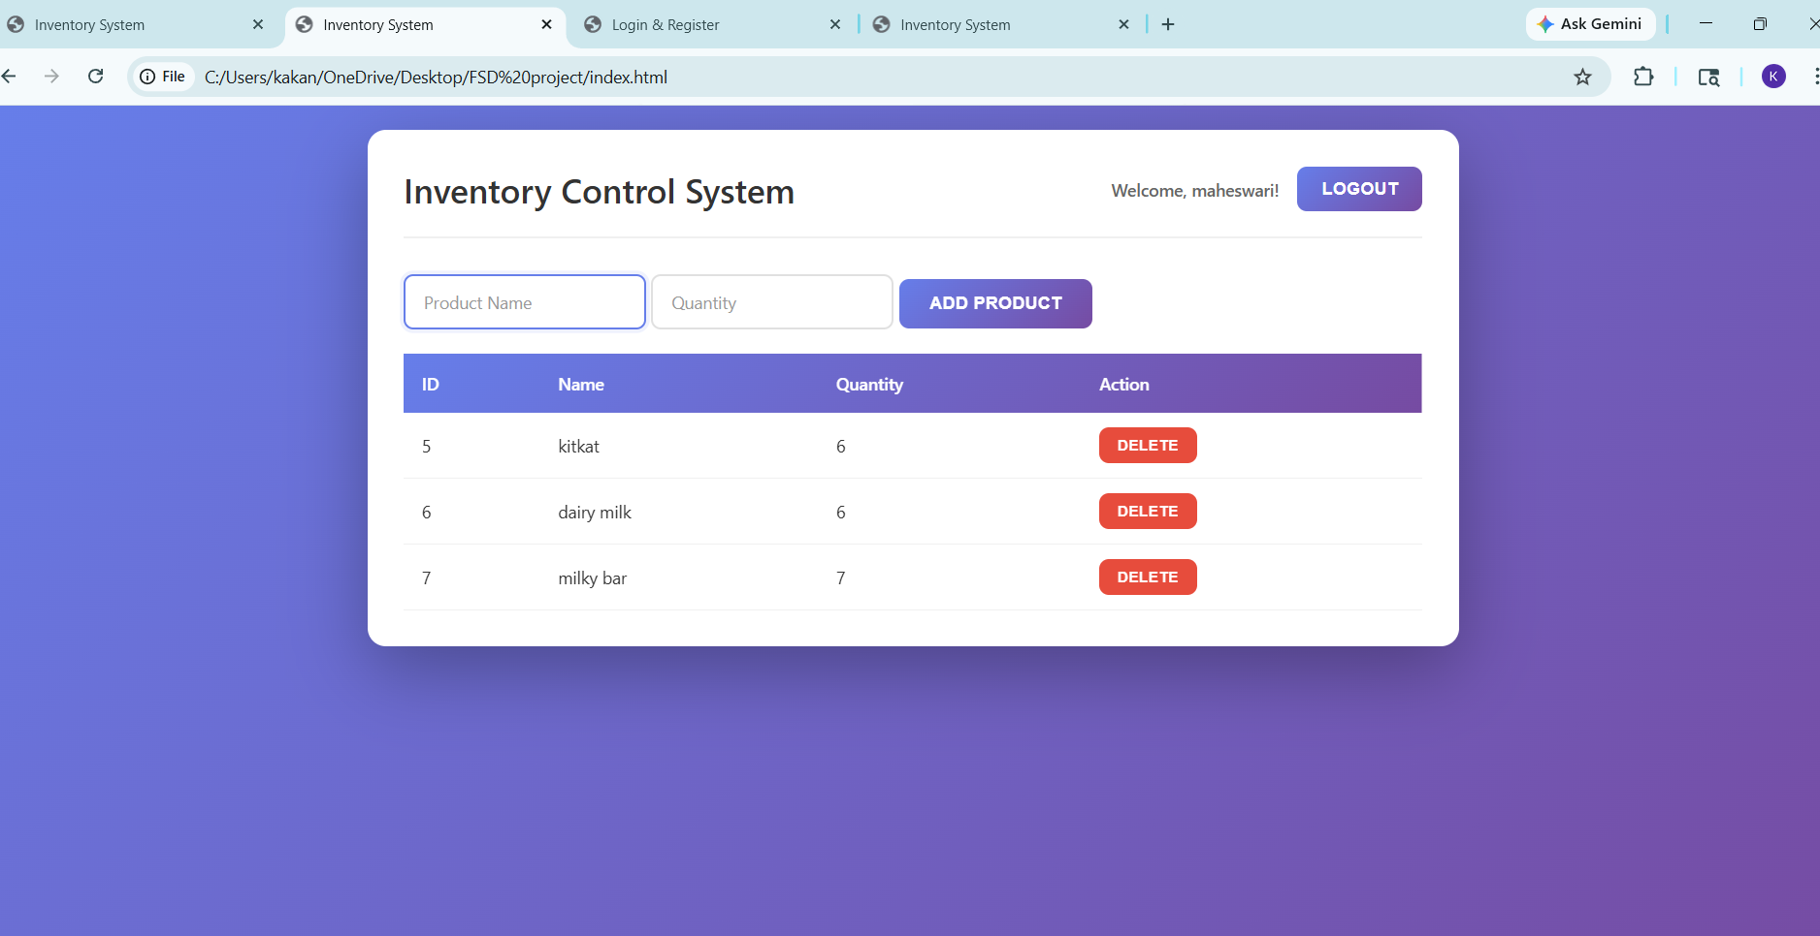
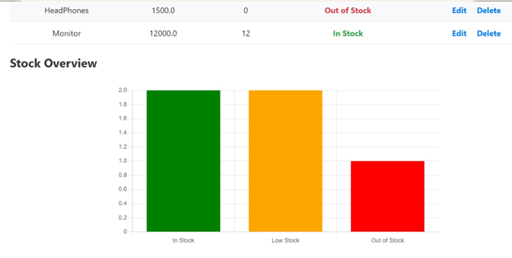
IMPLEMENTATION SCREENSHOTS
Admin can view the list of all products along with their quantities in a structured table format.
Admin can manage stock by removing items using the delete option to keep inventory updated.
1
2
3
4
5
6
7
8(C)
9

Slide 14
ADVANTAGES & LIMITATIONS
1
Advantages:
The system provides real-time updates of inventory, helping to avoid situations like overstocking or running out of products.
It supports scalability, meaning the system can handle increasing inventory and data as the business grows.
Helps prevent overstocking or running out of products.
Ensures secure access with login for authorized users only.
Limitations:
The system requires a computer and internet connection to operate.
Large amounts of data may slow down the system if not optimized properly.
Security depends on proper authentication; weak passwords can be a risk.
2
3
4
5
6
7
8
9

Slide 15
THANK YOU

